Slide 1
Quantal descriptions of Superdeformed states of
Ca and Ar
Makito Oi (Senshu University, Tokyo)
Eiji Ideguchi (CNS, University of Tokyo)

Slide 2
Introduction
Superdeformed states in light systems:
⁴⁰Ca(8p-8h); ³⁶Ar(4p-4h); ⁴⁰Ar (“4p-4h”)
Recently, ⁴²Ca(4p-4h? 8p-8h?).

Slide 3
Single-particle model space
proton
neutron
g_{9/2}
g_{9/2}
p_{1/2}
40
p_{1/2}
40
f_{5/2}
f_{5/2}
p_{3/2}
p_{3/2}
28
28
f_{7/2}
f_{7/2}
E_{F}
20
20
d_{3/2}
E_{F}
d_{3/2}
⁴²Ca
s_{1/2}
s_{1/2}
d_{5/2}
d_{5/2}
8
8

Slide 4
Self-consistent cranking
⁴²Ca
16
14
12
10
8
6
2
4

Slide 5
Occupation number
neutron
proton
p(4p-4h) x n(4p-2h)
proton
neutron
neutron
⁴²Ca

Slide 6
Quadrupole deformation
γ
1º
0º
0.54
β
0.52
Triaxiality
−16º
Angular momentum
Elongation
⁴²Ca
0.46
Angular momentum

Slide 7
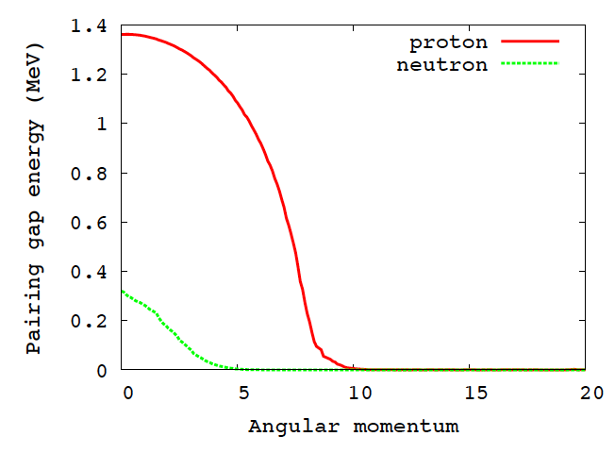
Pairing gap energy
⁴²Ca

Slide 8
Backbending plot
⁴²Ca

Slide 9
Moment of inertia
⁴²Ca

Slide 10
Backbending systematics

Slide 11
Conclusion
Rotational band in ⁴²Ca:
Cranked HFB calculation
Superdeformation?
8p-”6”h configuration [4p-4h x (2+2)p-2h ]
Backbending due to g_{9/2} at I=20.
Qt and high-spin experiments.

